Slide 1
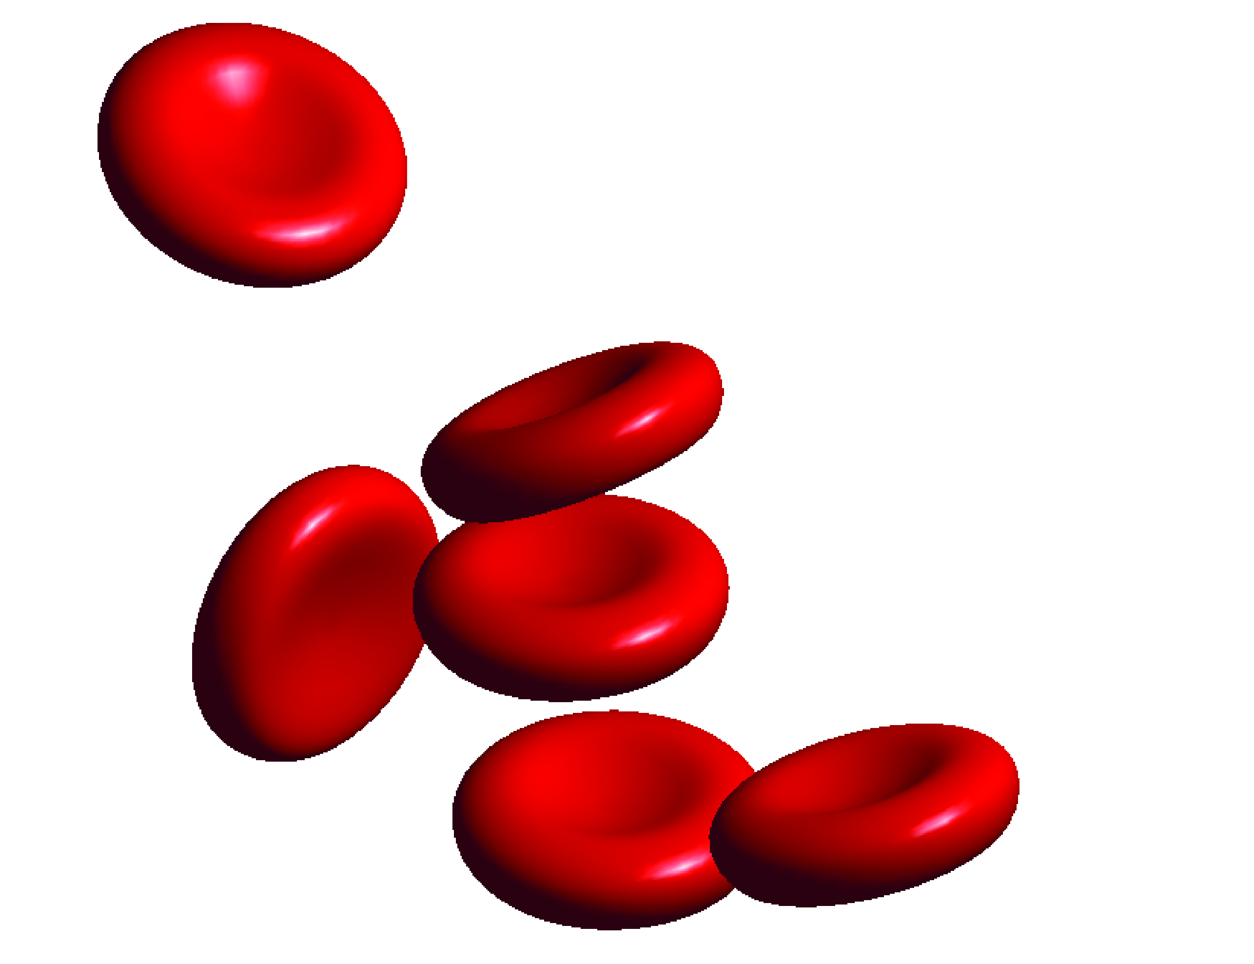
Developing A Hemodynamic Model for Improving Surgical Treatment of Vascular Disease
Jingliang Dong
Primary supervisor: Prof Jiyuan Tu
Secondary supervisor: Dr Kiao Inthavong

Slide 2
Applications of nasal studies
Outlines
Background and literature review
Computational fluid dynamics (CFD) model validation
Develop a downstream artery impedance model
Correlate hemodynamic predictions with a clinical predicator
Fluid-structure interaction analysis
Conclusions and future work
RMIT University©
SAMME
2
Notes:
of 36
2

Slide 3
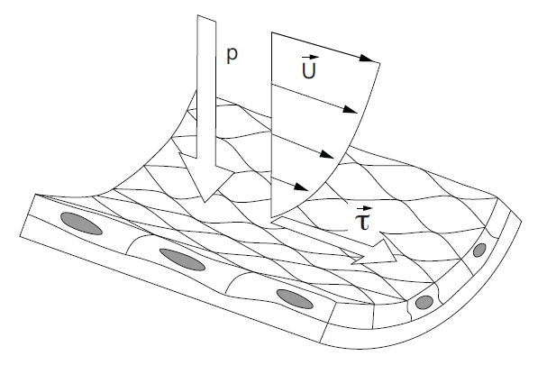
Background of this study
Endothelial cells experience two major hemodynamic forces in vivo, one is the fluid shear stress (τ), and the other is the circumferential stress (P).
Shear stress is negatively related to inner wall thickening in healthy individuals, while circumferential stress is positively correlated.
RMIT University©
SAMME
3
Notes:
of 36
3

Slide 4
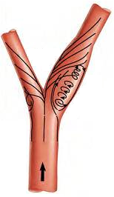
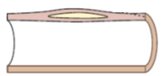
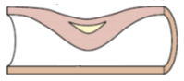
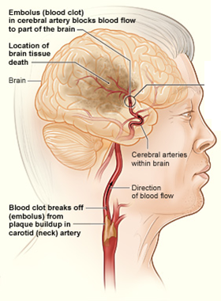
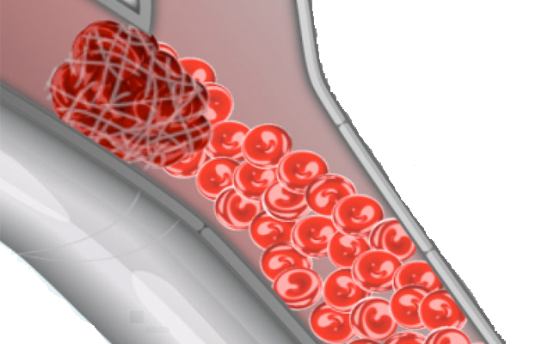
Stenosis and Stroke
low WSS
high WSS
Constrictive remodelling
RMIT University©
SAMME
4
Notes:
of 36
4

Slide 5
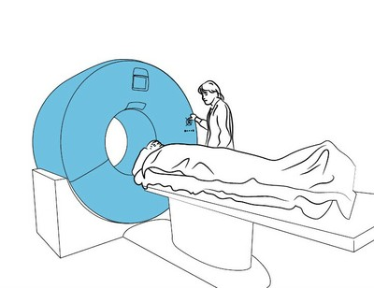
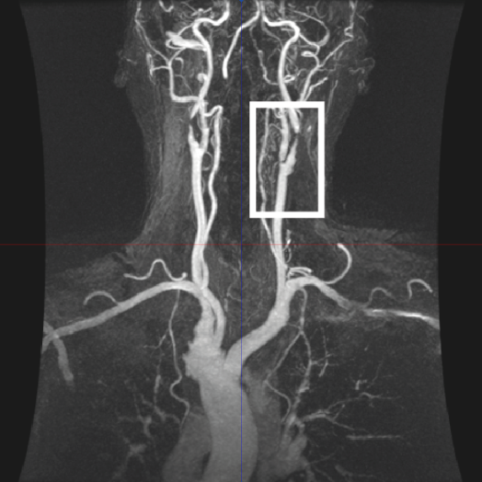
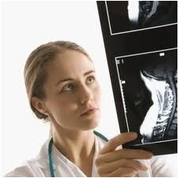
Applications of nasal studies
Vascular disease diagnosis
Stenosis severity assessment is limited to geometric measurement.
The ultimate evaluation of vascular disease largely relies on the experience of the treating physician.
RMIT University©
SAMME
5
Notes:
of 36
5

Slide 6
Literature review
Primary techniques:
in-vivo investigations:
Doppler and ultrasound-based techniques
Experimental modelling or in-vitro modelling:
Particle Image Velocimetry (PIV)
Computational modelling:
Computational fluid dynamics (CFD)
RMIT University©
SAMME
6
Notes:
of 36
6

Slide 7
Literature review
Pros and cons:
in-vivo investigations:
directly measure the hemodynamic forces
lack of spatial and temporal resolutions, and large measurement noise
Experimental modelling:
relatively high resolution
challenged by accurate representation of boundary conditions, vessel geometry and arterial vessel properties
RMIT University©
SAMME
7
Notes:
of 36
7

Slide 8
Literature review
Computational hemodynamics using CFD:
Powerful and insightful research tool for the identification of haemodynamics parameters, such as WSS
WSS remains one of the most intensively studied areas, primarily due to the identified strong correlation between low WSS and lesion development
In healthy large arteries, laminar blood flow. In diseased arteries with the presence of complex geometries or occlusion sites, disturbed flow with weak turbulence.
The fluid structure interaction also received an increased interest.
RMIT University©
SAMME
8
Notes:
of 36
8

Slide 9
Research gaps
Computational hemodynamics using CFD:
Obtain the patient-specific arterial geometry (CT, or MR) and blood flow data (Doppler ultrasound, or Phase-contrast MR).
Not all routine clinical examinations include blood flow measurements.
Current studies are largely limited in fluid dynamics fields.
The implementation of FSI is still not widely used due to the complex modelling requirements and high computational cost.
RMIT University©
SAMME
9
Notes:
of 36
9

Slide 10
Research questions
Computational hemodynamics using CFD:
How to utilize CT or MR images acquired from diseased artery samples to conduct CFD studies when the patient-specific inlet and outlet blood flow data is not available?
How to make the CFD results to be more meaningful?
Besides with the hemodynamic forces, effects of the local mechanical force on the initiation of stenosis need to be studied.
RMIT University©
SAMME
10
Notes:
of 36
10

Slide 11
Applications of nasal studies
Part 1: CFD model validation with PIV
RMIT University©
SAMME
11
Notes:
of 36
11

Slide 12
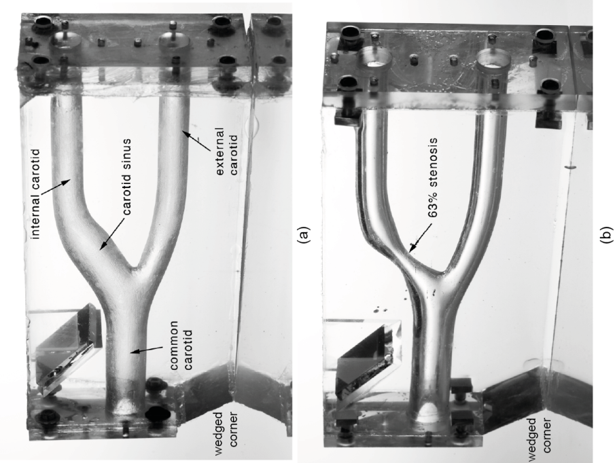
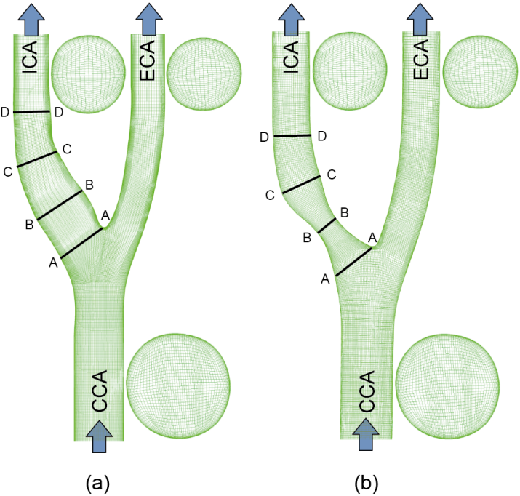
Applications of nasal studies
CFD model validation with PIV
Averaged human tuning-fork shaped carotid bifurcation (TF-AHCB) is used as a benchmark for comparison.
Both numerical and experimental^{[1]} studies used steady flow rate at Re = 400 and Re = 800.
^{[1]} Buchmann NA, et al., J. Biomech. Sci. Eng., 5 (2010):421-435
RMIT University©
SAMME
12
Notes:
of 36
12

Slide 13
Applications of nasal studies
CFD model validation with PIV
The flow division between the internal carotid artery branch (ICA) and the external carotid artery branch (ECA) is assumed to be constant 7:3.
The blood flow is assumed to be Newtonian fluid, since the carotid artery is in relatively large size, and blood cells can hardly be deformed by the flow velocity.
The fluid domain was meshed into structure mesh elements – Hexahedral
The transition SST model was used to capture the transitional flow downstream of the stenosis site.
RMIT University©
SAMME
13
Notes:
of 36
13

Slide 14
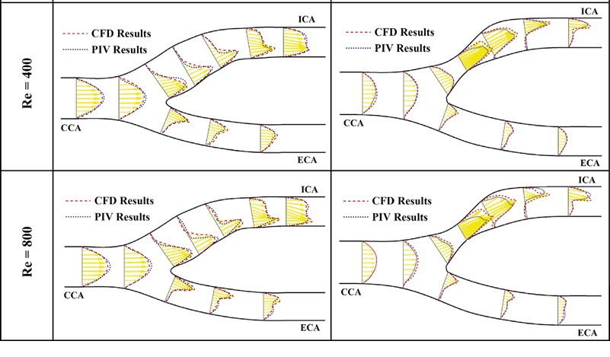
Applications of nasal studies
CFD model validation with PIV
RMIT University©
SAMME
14
Notes:
of 36
14

Slide 15
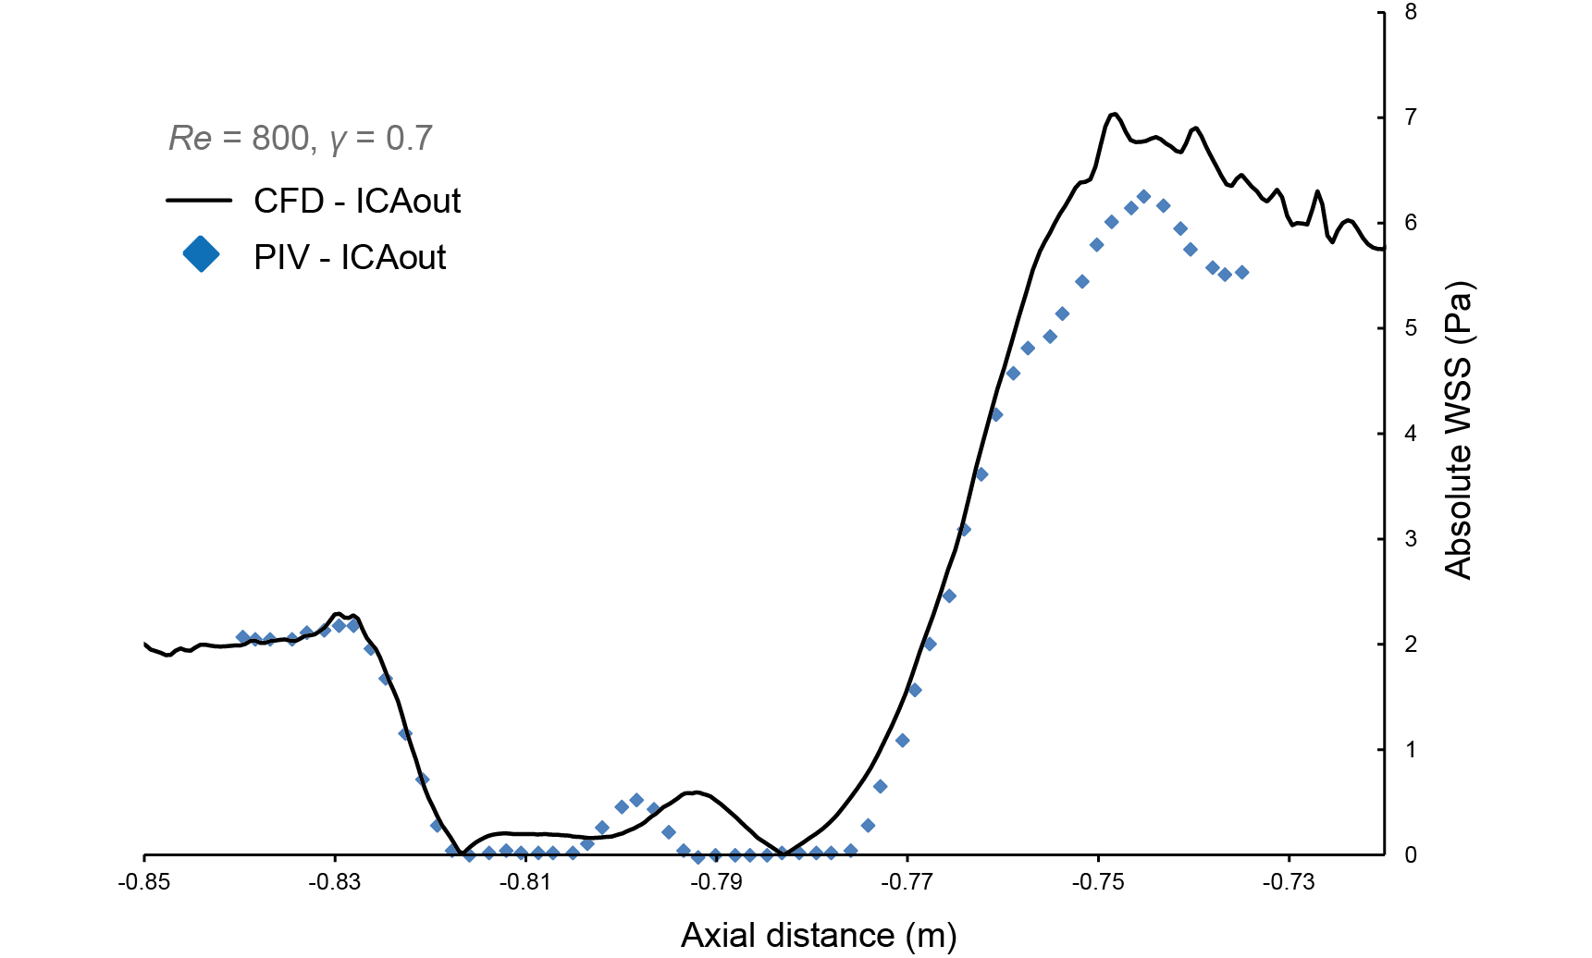

Applications of nasal studies
CFD model validation with PIV
Re = 800
RMIT University©
SAMME
15
Notes:
of 36
15

Slide 16
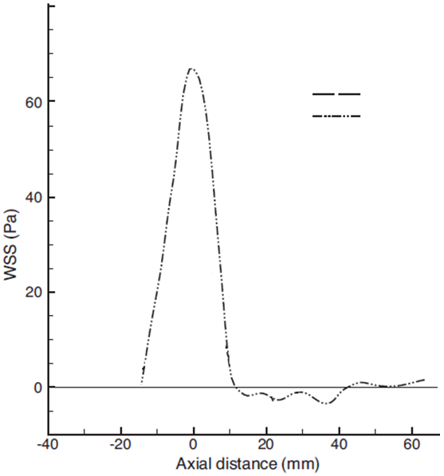

Applications of nasal studies
CFD model validation with PIV
CFD
PIV
Re = 800
RMIT University©
SAMME
16
Notes:
of 36
16

Slide 17
Applications of nasal studies
Part 2: Hemodynamics analysis of carotid artery bifurcations: downstream vascular impedance model^{[1]}
^{[1]} Jingliang Dong, KKL Wong, JY Tu. “Hemodynamics analysis of patient‐specific carotid bifurcation: A CFD model of downstream peripheral vascular impedance”, International Journal for Numerical Methods in Biomedical Engineering, 29 (2013): 476-491. IF = 1.31
RMIT University©
SAMME
17
Notes:
of 36
17

Slide 18
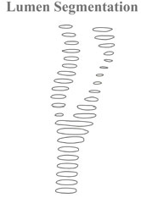
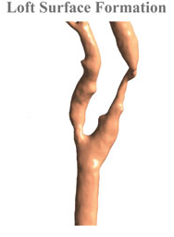
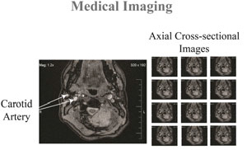

Applications of nasal studies
Carotid artery bifurcation reconstruction
High resolution MRI of carotid bifurcations was performed on patients using a 1.5 T General Electric scanner (pixel size 0.63 mm³).
The inner wall contours were extracted by an automated detection algorithm applied to each slice.
The lumen contours were ‘lofted’ together to construct into a continuous lumen surface.
RMIT University©
SAMME
18
Notes:
of 36
18

Slide 19
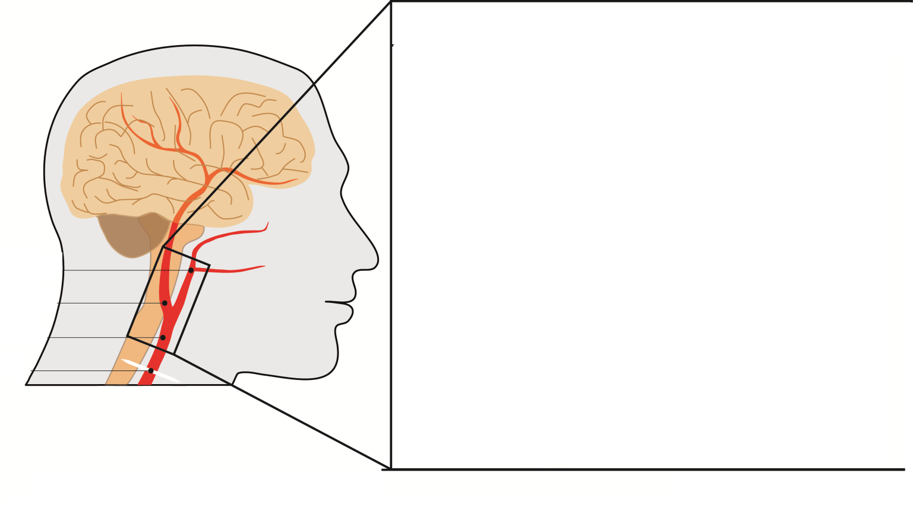
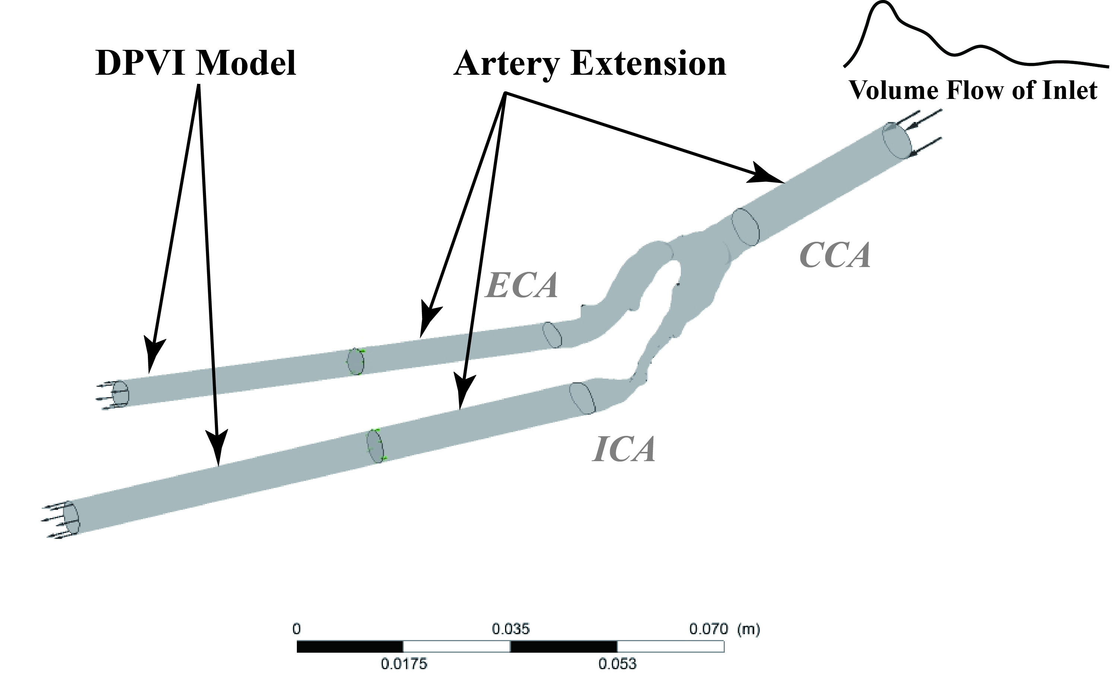
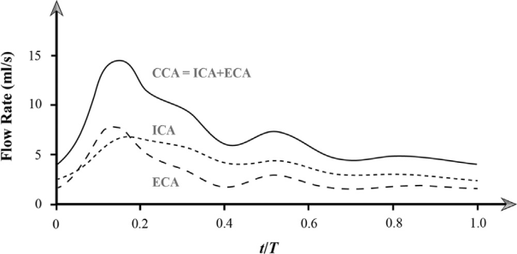
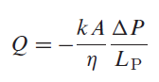
Applications of nasal studies
Downstream peripheral vascular impedance model
Two porous beds with different permeability configuration were connected with ICA and ECA branches to represent their transient DPVI
Darcy’s Law is used to establish the correlation between the pressure drop across the porous bed ΔP, the volume flow rate Q, and the permeability k
RMIT University©
SAMME
19
Notes:
of 36
19

Slide 20
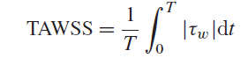
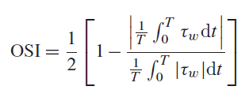
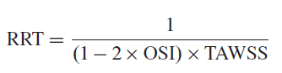
Applications of nasal studies
Results extracting
Time Averaged Wall Shear Stress
> 40 Pa or < 0.4 Pa
Oscillatory Shear Index
0 <
< 0.5
Relative Residence Time
> 10 m²/N
RMIT University©
SAMME
20
Notes:
of 36
20

Slide 21
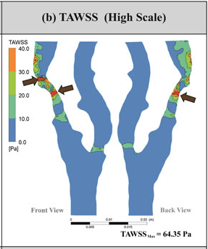
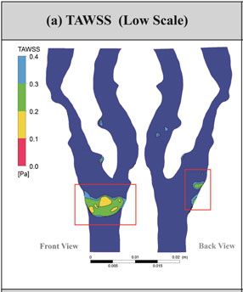
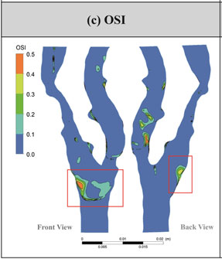
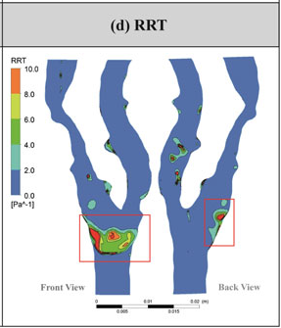
Applications of nasal studies
Results based on the DPVI model
The stenosis site experiences a very high shear stress (peaking at 64.35 Pa).
The bulge at the bifurcation experiences a low oscillatory shear stress with longer residence time.
RMIT University©
SAMME
21
Notes:
of 36
21

Slide 22
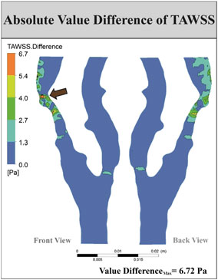
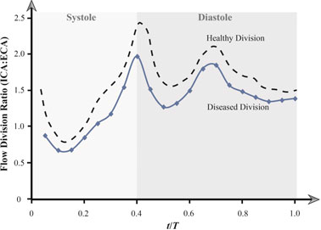
Applications of nasal studies
Results Comparison
A 6.72 Pa difference is found at the stenosis throat, and the model using constant flow division assumption over predicts about 10.44%.
The diseased flow division profile (ICA/ECA) is constantly below the healthy condition.
RMIT University©
SAMME
22
Notes:
of 36
22

Slide 23
Part 3: Image-based computational hemodynamics evaluation of atherosclerotic carotid bifurcation models^{[2]}
^{[2]} Jingliang Dong, K Inthavong, JY Tu. “Image-based computational hemodynamics evaluation of atherosclerotic carotid bifurcation models”, Computers in Biology and Medicine, 43 (2013):1353-1362. IF = 1.162
RMIT University©
SAMME
23
Notes:
of 36
23

Slide 24
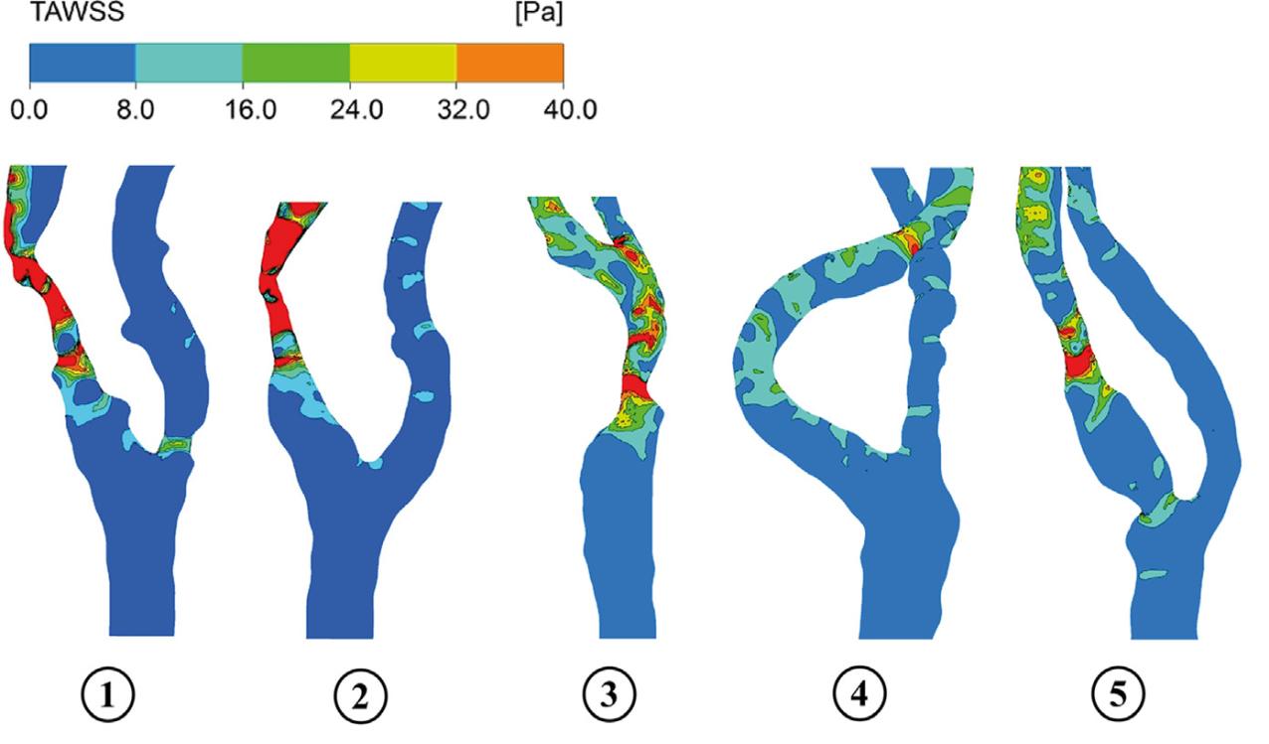
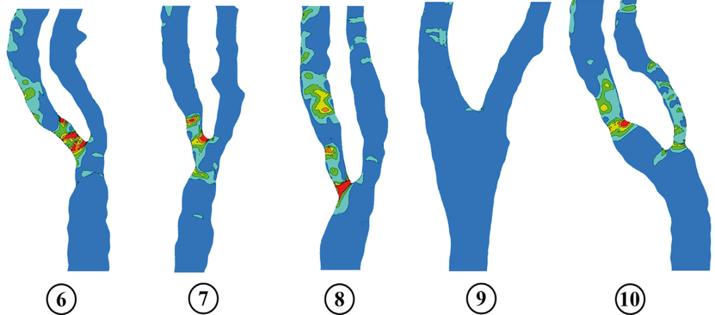
Applications of nasal studies
WSS based results
RMIT University©
SAMME
24
Notes:
of 36
24

Slide 25
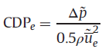
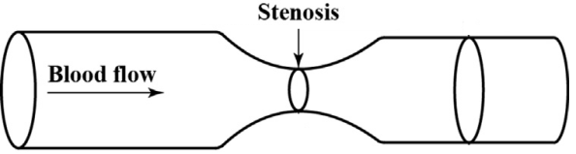
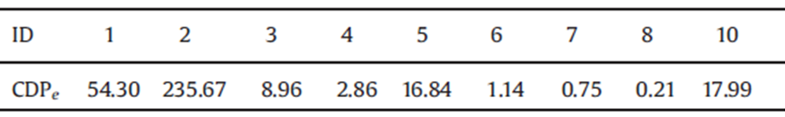
Applications of nasal studies
Pressure drop coefficient
Pressure drop based diagnostic parameter, pressure drop coefficient (CDP_{e}), is introduced for stenosis severity stratification.
Defined as the ratio of mean trans-stenotic pressure drop to the proximal dynamic pressure.
If the CDP_{e} value is larger than 161.41, proper vascular interventions should be recommended.
RMIT University©
SAMME
25
Notes:
of 36
25

Slide 26
Part 4: Fluid–structure interaction analysis of the left coronary artery^{[3]}
^{[3]} Jingliang Dong, Z Sun, K Inthavong and JY Tu. "Fluid-structure interaction analysis of the left coronary artery with variable angulation“, Computer Methods in Biomechanics and Biomedical Engineering, (2014): Accepted. IF = 1.393
RMIT University©
SAMME
26
Notes:
of 36
26

Slide 27
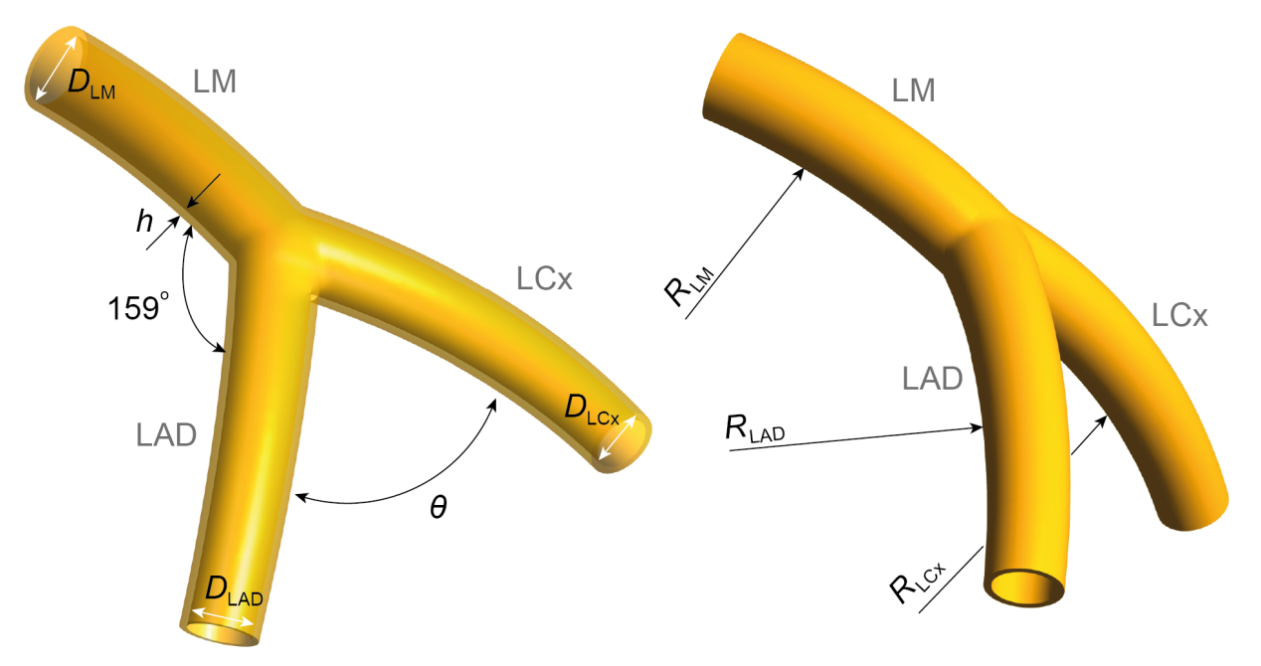
Idealized model development
A set of idealized models were developed based on 19 post-mortem casts of normal human coronary artery trees.
Five idealized models were constructed with angles of 70º, 80º, 90º, 100º and 110º.
The angle formed by LM and LAD was kept constant.
Length of LM | 11.0 mm
Dia. of LM | 4.0 mm
Dia. of LAD | 3.4 mm
Dia. of LCx | 3.0 mm
Rad. of curvature of LAD | 42.8 mm
Rad. of curvature of LCx | 39.3 mm
Angulation between LM and LAD | 159º
RMIT University©
SAMME
27
Notes:
of 36
27

Slide 28
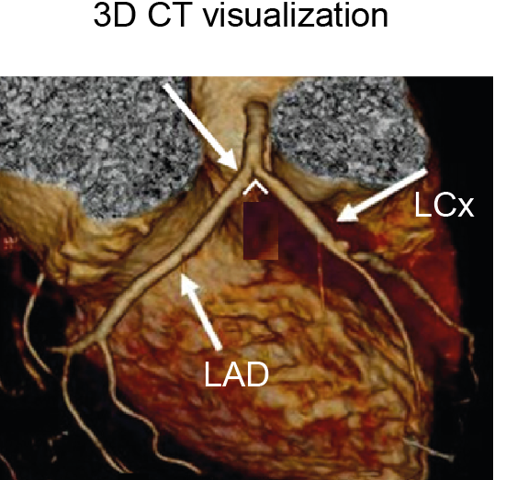
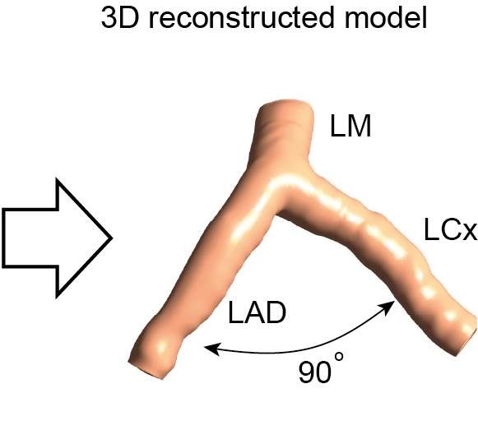
Applications of nasal studies
Image-based model reconstruction
RMIT University©
SAMME
28
Notes:
of 36
28

Slide 29
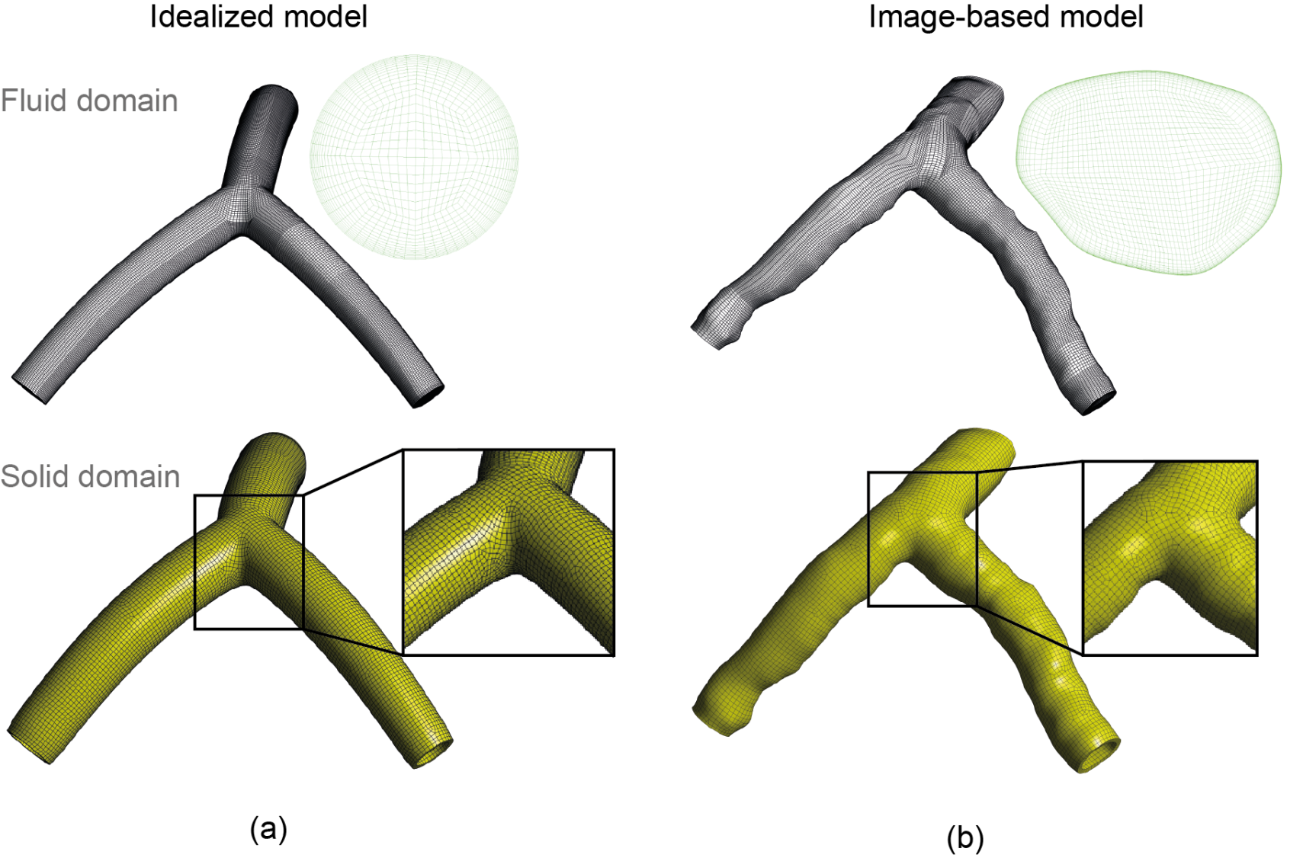
Structure mesh results
The vessel wall was artificially constructed with a constant thickness h = 0.4mm.
RMIT University©
SAMME
29
Notes:
of 36
29

Slide 30
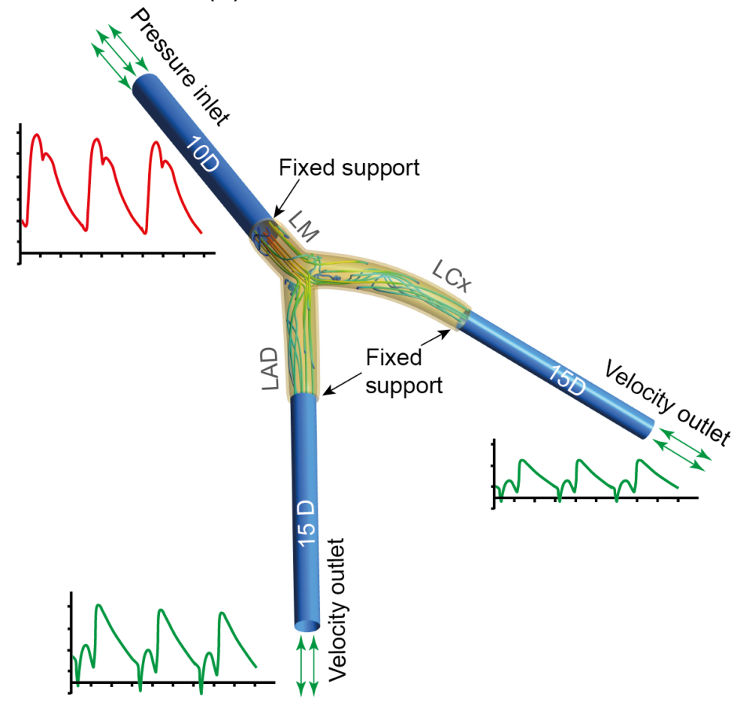
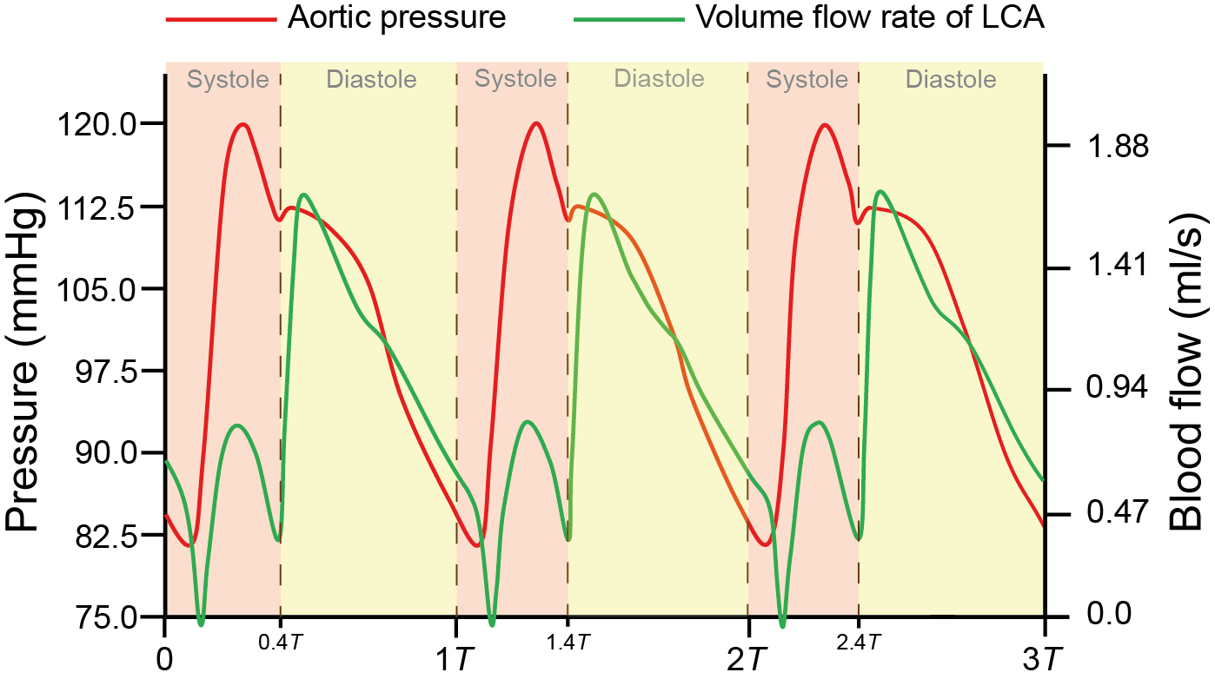
Boundary setup
Physiological pulsatile flow rate and pressure at the aorta was adopted.
Aortic pressure was applied at inlet, and velocity conditions were imposed on outlets.
RMIT University©
SAMME
30
Notes:
of 36
30

Slide 31
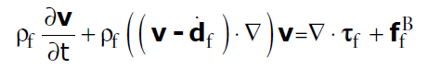
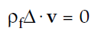
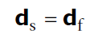
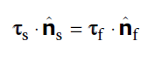
Governing equations
Momentum and mass conservation equations in Arbitrary Lagrangian-Eulerian (ALE) form:
Displacements and tractions at the FSI interface:
RMIT University©
SAMME
31
Notes:
of 36
31

Slide 32
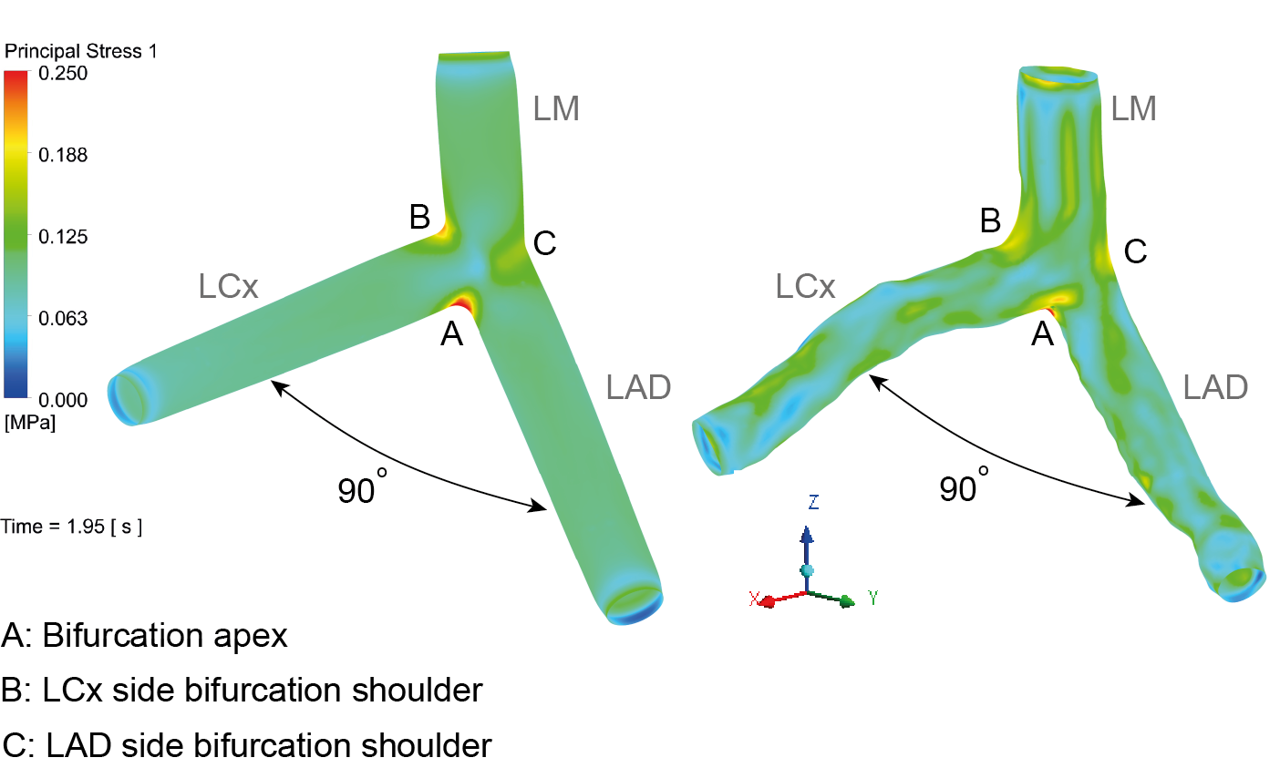
First principal stress results
The first principal stress distribution of the image-based model shows a similar result when compared with the idealized model with the same angle.
The representative models can be used for numerical analysis.
RMIT University©
SAMME
32
Notes:
of 36
32

Slide 33
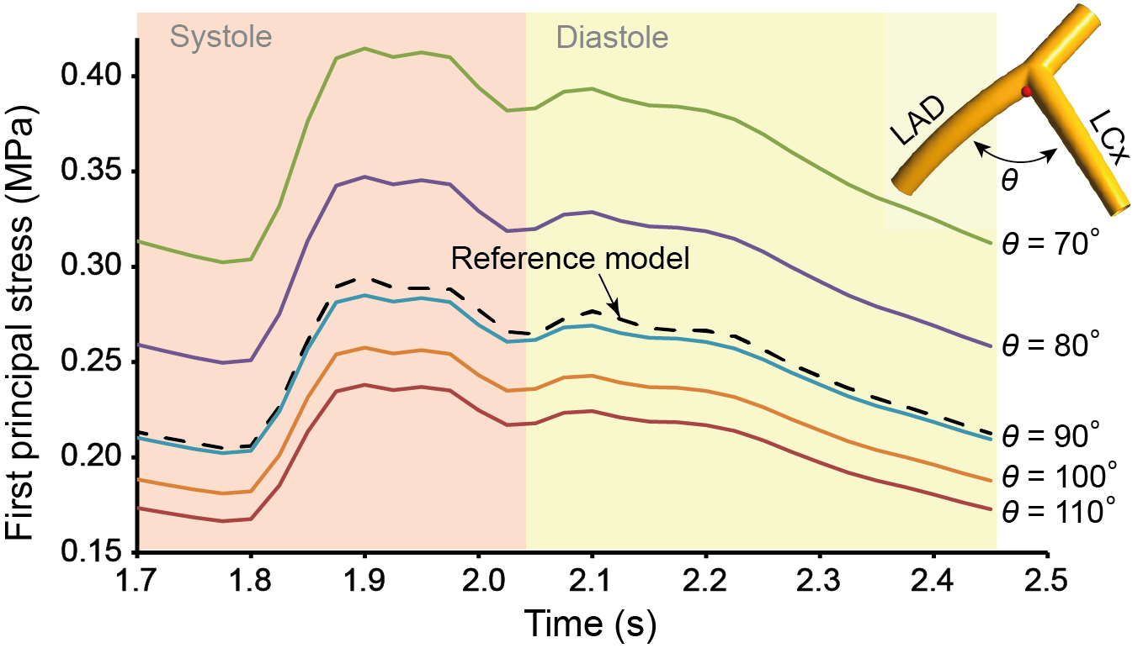
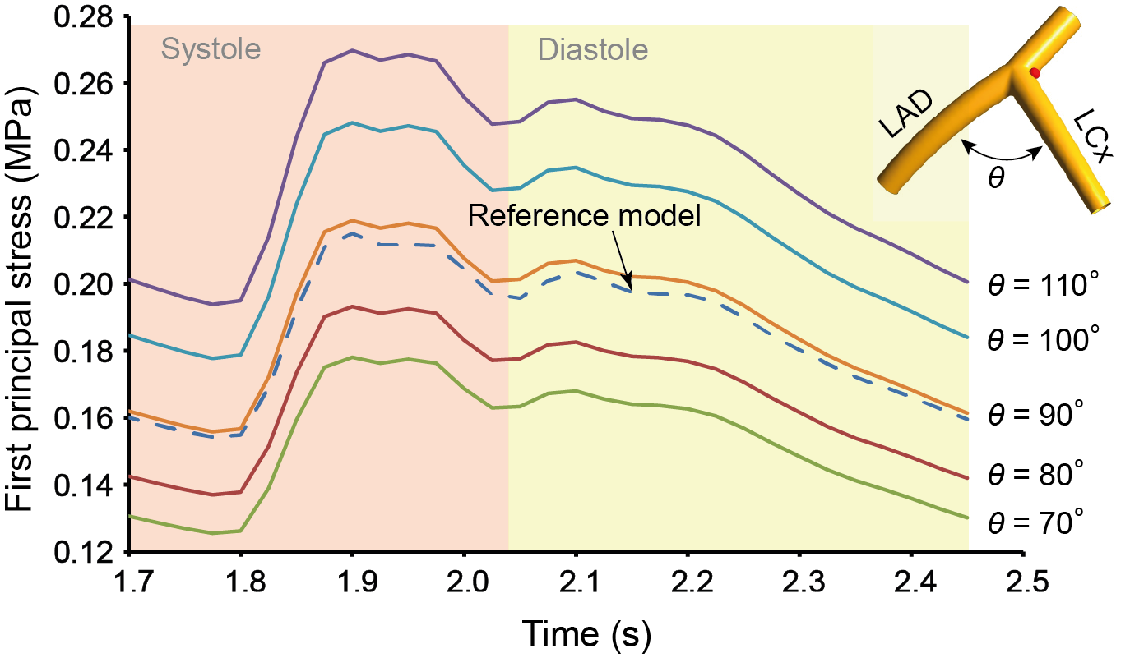
First principal stress results
It represents the maximum tensile stress included in the vessel wall due to the pulsatile loading of blood flow.
The stress variation at the bifurcation apex is found to negatively correlate to the bifurcation angle.
A positive correlation is found between the first principal stress at the LCx side bifurcation shoulder and the bifurcation angle.
RMIT University©
SAMME
33
Notes:
of 36
33

Slide 34
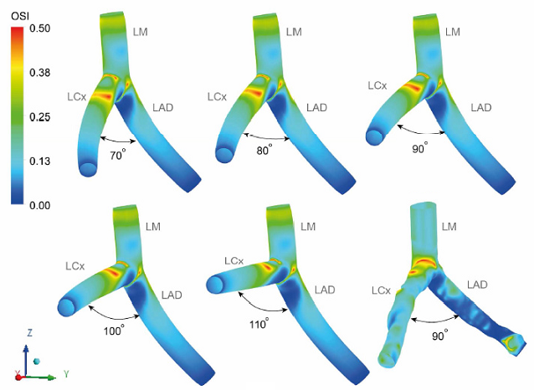
Hemodynamic results
High OSI regions are concentrated at the origins and proximal LCx branches with no significant differences among studied models.
RMIT University©
SAMME
34
Notes:
of 36
34

Slide 35
Conclusions and future work
The proposed DPVI model improves simulation accuracy.
Clinical trial oriented indicators can be extracted from CFD simulations.
Bifurcation branch orientation significantly alters mechanical stress distribution.
The current CFD/FSI model can provided functional results, so as to assist the treating physician in diagnosis.
The prediction accuracy of transitional flow still needs to be improved.
RMIT University©
SAMME
35
Notes:
of 36
35

Slide 36
Journal Publications
Jingliang Dong, Z Sun, K Inthavong and JY Tu. "Fluid-structure interaction analysis of the left coronary artery with variable angulation“, Computer Methods in Biomechanics and Biomedical Engineering, (2014): Accepted. IF = 1.393
K Inthavong, Jingliang Dong, JY Tu and W Yang. “A numerical and experimental study on the fluid dynamics in a realistic pharyngeal airway”, Computer Methods in Biomechanics and Biomedical Engineering, (2014): Under review. IF = 1.393
Jingliang Dong, NA Buchmann, K Inthavong, JY Tu. “Intravascular flow measurements of idealized human carotid artery bifurcations”, Medical & Biological Engineering & Computing, (2014): Submitted. IF = 1.790
K Inthavong, AP Mouritz, Jingliang Dong, JY Tu. “Inhalation and deposition of carbon and glass composite fibre in the respiratory airway”, Journal of Aerosol Science, Vol. 65 (2013): 58-68. IF = 2.686
Jingliang Dong, K Inthavong, JY Tu. “Image-based computational hemodynamics evaluation of atherosclerotic carotid bifurcation models”, Computers in Biology and Medicine, 43 (2013):1353-1362. IF = 1.162
Jingliang Dong, KKL Wong, JY Tu. “Hemodynamics analysis of patient‐specific carotid bifurcation: A CFD model of downstream peripheral vascular impedance”, International Journal for Numerical Methods in Biomedical Engineering, 29 (2013): 476-491. IF = 1.31

Slide 37
Conference Publications
Jingliang Dong, Z Sun, K Inthavong, JY Tu. “Fluid-structure interaction analysis of representative left coronary artery models with different angulations”, Computing in Cardiology, 2013, 5-8.
Jingliang Dong, X Wang, JY Tu. “Numerical research about the internal flow of steam-jet vacuum pump: evaluation of turbulence models and determination of the shock-mixing layer”, The 18th International Vacuum Congress, Physics Procedia, 2012, Vol. 32: 614-622.
Jingliang Dong, KKL Wong, JY Tu. “Effect of Local Wall Shear Stress on Low-density lipoprotein Transportation in Atherosclerotic Carotid Bifurcation”, International Proceedings of Chemical, Biological & Environmental Engineering, 2012, Vol. 34: 62-67.
KKL Wong, Jingliang Dong, JY Tu. “Numerical Study of Stenosed Carotid Bifurcation Models Based on Wall Shear Stress Distribution”, International Proceedings of Chemical, Biological & Environmental Engineering, 2012, Vol. 34: 40-44.
Jingliang Dong, KKL Wong, Z Sun, JY Tu. “Numerical analysis of stent porosity and strut geometry for intra-saccular aneurysmal flow”, Computing in Cardiology, 2011, 477-480.
KKL Wong, Jingliang Dong, SCP Cheung, JY Tu. “Hemodynamic analysis of virtual stent design for atherosclerotic carotid artery”, Computing in Cardiology, 2011, 157-160.

Slide 38

Thanks for your attention !

